Slide 1


COGNITIVE
SERVICES
Giving your apps/bots
a human side
Amy Nicholson
Technical Evangelist
Notes:
Now that you built your bot, it’s time to add smarts to it and make it more useful and engaging for your users. An intelligent bot has human-like senses and skills. It is able to understand what we are saying or writing in natural language and respond back, see our world as we see it, discover information and extract knowledge from different sources to provide useful answers, and more importantly learn as it acquires more experience to continuously improve its capabilities. Sounds daunting, but we are here to help you add some of these cognitive skills to your bot.
What are Cognitive Services? Microsoft Cognitive Services are a new collection of intelligence and knowledge APIs that enable developers to ultimately build smarter apps.
Currently 21 APIs and will grow.
Cognitive Services includes:
Vision: From faces to feelings, allow apps to understand images and video
Speech: Hear and speak to users by filtering noise, identifying speakers, and understanding intent
Language: Process text and learn how to recognize what users want
Knowledge: Tap into rich knowledge amassed from the web, academia, or your own data
Search: Access billions of web pages, images, videos, and news with the power of Bing APIs

Slide 2
&

Slide 3









2015
Intelligence
2012
Big Data
2008
Cloud

Slide 4



AI Services Cortana Intelligence Suite
Information Management
Big Data Stores
Machine Learning and Analytics
Intelligence
Business apps
People
Data Factory
Data Lake Store
Machine Learning
Cognitive Services
Data Catalog
SQL Data
Warehouse
Data Lake Analytics
Bot Framework
Custom apps
HDInsight
(Hadoop and Spark)
Apps
Event Hubs
Cortana
Stream Analytics
Sensors and devices
Dashboards & Visualizations
Automated systems
Power BI
Data
Intelligence
Action
Notes:
Natural and proactive interaction: Interact with your data and using natural language and speech through Cortana
Intelligent agents: Build intelligent agents or Bots that allow your users to interact with your intelligent solutions in more contextual and natural ways, including in your communications and social platforms—text/sms, Facebook, WhatsApp, WeChat, Slack, Skype, and more
Cognitive APIs: Add vision, speech, text, recommendations and face and emotion detection to your application to gain valuable insights for your business

Slide 5
Microsoft Azure Machine Learning
A fully managed cloud service that enables you to
easily build, deploy, and share predictive analytics solutions.

Slide 6
Microsoft Azure Machine Learning
Creating great ML models takes:
Lots of high quality, tagged data. Quality is key!
Lots of expertise
Lots and lots of computing power
Commitment to improvement

Slide 7
Microsoft Cognitive Services
“Enable your apps to see, hear, interpret, and interact in more human ways.”
“API’s for accessing the real world”
“Really hard problems Microsoft has already solved so you don’t have to”

Slide 8
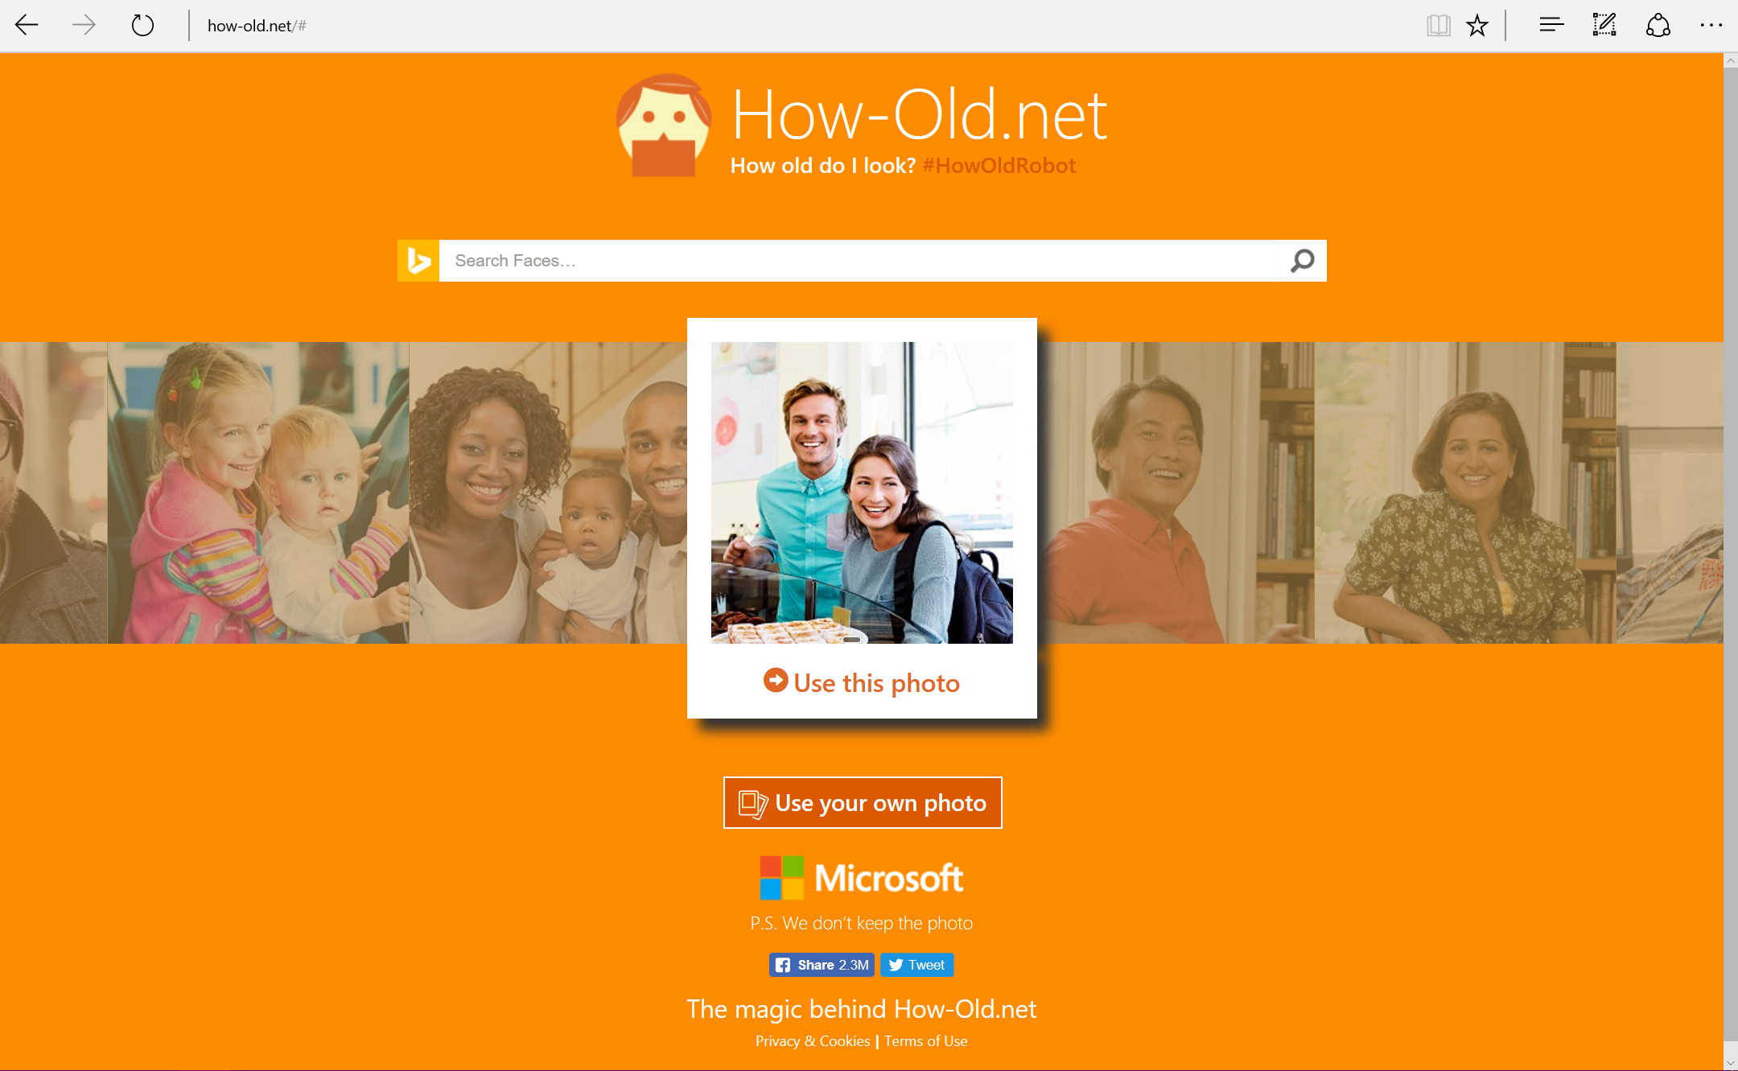
http://bit.ly/howoldoutcome

Slide 9
Microsoft Cognitive Services
Vision
From faces to feelings, allow your apps to understand images and video
Computer Vision | Emotion | Face | Video
Notes:
Image analysis – content id and labelling
OCR
Recognise emotions in images and video
Face detection and verification
Video stabilisation, face tracking and motion detection

Slide 10
Microsoft Cognitive Services
Web version:
Video removed but can be found here
https://www.microsoft.com/cognitive-services/en-us/video-api
Notes:
Image Stabilisation

Slide 11
Microsoft Cognitive Services
Speech
Hear and speak to your users, identify speakers
Custom Recognition | Speaker Recognition | Speech API
Notes:
Speech recognition
Text to Speech
Speech intent recognition
Custom speech recognition models for speaker style or difficult environments eg. Noisy
Spell check
LUIS – language understanding intent and entities for NLP
Text analytics to detect sentiment, key phrases, topics and language from text

Slide 12
Microsoft Cognitive Services
Language
Process text, understand intent, translate
Bing Spell Check | Language Understanding | Linguistic Analysis |
Text Analytics | Web Language Model | Translator
Notes:
Speech recognition
Text to Speech
Speech intent recognition
Custom speech recognition models for speaker style or difficult environments eg. Noisy
Spell check
LUIS – language understanding intent and entities for NLP
Text analytics to detect sentiment, key phrases, topics and language from text

Slide 13
Microsoft Cognitive Services
Knowledge
Academic Knowledge | Entity Linking
Knowledge Exploration | Recommendations
Notes:
Academic – tap into academic content in the MS academic graph
Entity linking- recognise and identify separate entity basd on context.
Recommendations - provide personalised product recommendations for customers, frequently bought, item to item, personalised user

Slide 14
Microsoft Cognitive Services
Search
Access billions of web pages, images, videos, and news with the power of Bing APIs
Bing Web Search | Bing Image Search
Bing News Search | Bing Video Search
Bing Auto Suggest
Notes:
various Bing search Apis for news, images, videos

Slide 15

REAL-TIME ID CHECK
FACIAL API
MICROSOFT COGNITIVE
https://www.youtube.com/watch?v=aEBi4OpXU4Q
Notes:
Face API, which can compare the photos and return a match within milliseconds, even from a photo that might not be of the highest quality.

Slide 16
SEEING AI
MICROSOFT COGNITIVE
https://www.youtube.com/watch?v=R2mC-NUAmMk

Slide 17




Σ
Cognitive Services
Azure
Machine Learning
Data Science
Languages
Computational
Network Toolkit
Commodity
Drag & Drop
Code

Slide 18

What is Azure Machine Learning
Data
Clients
API
ML STUDIO
Model is now a web service that is callable
Blobs and Tables
Hadoop (HDInsight)
Relational DB (Azure SQL DB)
Integrated development environment for Machine Learning
Monetize the API through our marketplace
Notes:
The elegance of the solution is in its simplicity – something that has been lacking in the machine learning space
The first issue many enterprises face is data ingestion. With the cloud, you can bring in data sources with the ease of a drop down or drop your on-premises data set into the built in storage space. Users can then model in our development environment – Machine Learning Studio
where we’re offering R, Python and SQLite as first class citizens in addition to our world-class Microsoft algorithms.
The second issue – and often the primary one – is putting finished work into production in a way others can use. Client devices, websites, mobile applications, excel spreadsheets you name it anything that supports HTTP requests.
We’ve heard from many data scientists that they model in R on a Linux stack but then have to hand over their work to developers who need to translate that into another language to actually make it work.
This time consuming and unnecessary process has been eliminated with our system, as the model is with a click transformed into a web service end-point that can run over any data, anywhere and connect to any solution or client.
Next, not only can this model be put into production for your company, it can be made available for the world on our Machine Learning Marketplace. Microsoft hosts your solution and markets it for you, while you have the freedom to brand and monetize as you see fit.

Slide 19
COGNITIVE
SERVICES
https://www.microsoft.com/cognitive-services/
Amy Nicholson, Technical Evangelist
@amykatenicho amynic@microsoft.com
Notes:
Now that you built your bot, it’s time to add smarts to it and make it more useful and engaging for your users. An intelligent bot has human-like senses and skills. It is able to understand what we are saying or writing in natural language and respond back, see our world as we see it, discover information and extract knowledge from different sources to provide useful answers, and more importantly learn as it acquires more experience to continuously improve its capabilities. Sounds daunting, but we are here to help you add some of these cognitive skills to your bot.
What are Cognitive Services? Microsoft Cognitive Services are a new collection of intelligence and knowledge APIs that enable developers to ultimately build smarter apps.
Currently 21 APIs and will grow.
Cognitive Services includes:
Vision: From faces to feelings, allow apps to understand images and video
Speech: Hear and speak to users by filtering noise, identifying speakers, and understanding intent
Language: Process text and learn how to recognize what users want
Knowledge: Tap into rich knowledge amassed from the web, academia, or your own data
Search: Access billions of web pages, images, videos, and news with the power of Bing APIs

